Slide 1
Emotion Recognition in Conversations
Mainly focus on the recent works.

Slide 2
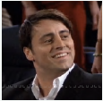
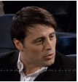
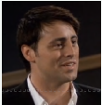


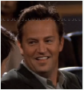
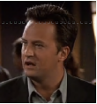
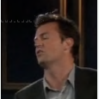
Task Intro.
Emotion Recognition: predict the emotion of a single sentence.
Surprise
Neutral
Neutral
Anger
铁汁, 你喜欢这部电影嗦?
你真的喜欢哈?
具体喜欢它哪一pa?
有袋鼠的那一场你觉得如何?
你批娃睡着了!
Joey
Chandler
嗯咯, 是滴!
全部嗷, 我们可以溜了嘛
..., 世界大战的电影里面冒出
一只袋鼠, 我表示很惊讶
你莫走嘛,
哎哟, 骚瑞
Joy
Neutral
Surprise
Sadness
A conversation: a sequence of utterances with different emotions.
The goal: predicting the emotion of every utterance in the context of other utterances.

Slide 3
Task Intro.
Key components of conversation.
Surprise
Neutral
Neutral
Anger
铁汁, 你喜欢这部电影嗦?
你真的喜欢哈?
铁汁, 你喜欢这部电影嗦?
你真的喜欢哈?
具体喜欢它哪一pa?
有袋鼠的那一场你觉得如何?
你批娃睡着了!
具体喜欢它哪一pa?
有袋鼠的那一场你觉得如何?
你批娃睡着了!
Joey
Joey
Chandler
Chandler
嗯咯, 是滴!
全部嗷, 我们可以溜了嘛
..., 世界大战的电影里面冒出
一只袋鼠, 我表示很惊讶
你莫走嘛,
哎哟, 骚瑞
嗯咯, 是滴!
全部嗷, 我们可以溜了嘛
..., 世界大战的电影里面冒出
一只袋鼠, 我表示很惊讶
你莫走嘛,
哎哟, 骚瑞
Joy
Neutral
Surprise
Sadness
No.1 utterance (including 3 modals: textual, visual, audio)
Feature modeling
No.2 contextual utterance
Conversational context modeling
No.3 conversation participator (speaker, e.g. Joey and Chandler)
Speaker modeling
No.4 emotion labels
Emotion augmentation
No.5 the topic of the conversation (e.g. movie)
Key phrase emphasis

Slide 4




Task Intro.
Dataset
Audio
Visual
Textual
IEMOCAP
dyadic conversations with 6 emotions: Neutral; Joy; Sadness; Anger; Frustrated; Excited.
MELD
multi-speaker conversations with 7 emotions: Neutral; Joy; Sadness; Anger; Surprise; Fear; Disgust.
Textual
EmoryNLP
multi-speaker conversations with 7 emotions: Neutral; Joy; Sadness; Anger; Surprise; Fear; Disgust.
DailyDialog
dyadic conversations with 7 emotions: Neutral; Joy; Sadness; Anger; Surprise; Fear; Disgust.
EmotionLines
include 2 datasets: (1) dyadic; (2) multi-speaker. 7 emotions.
...
老友记养活了好几个数据集...但是这些数据集的质量不是很高.

Slide 5
How to train.
Pipeline: Two step
1. Extract the textual, visual, and audio features from the data.
Textual
CNN
Textual
BERT
Train: Emotion recognition
Therefore, the representation contains no conversational context information.
2. Conversational context modeling.
Context Modeling
A conversation
Predict for every utterance in the conversation
Freezing
Batch size can be set to a normal number: 32; 64

Slide 6
How to train.
Online: One step
Context Modeling
CNN
Predict for every utterance in the conversation
A conversation
RNN
BERT
Textual
No Emotion recognition to extract textual features; Emotion Recognition directly.
Batch size can be set to a small number due to the parallel prediction. 1-8, usually. For BERT and other pretrained models, the largely required memory also limits the batch size.

Slide 7
How to train.
Online: One step, one utterance prediction one time
Context Modeling
CNN
The number of utterances in context is usually small.
Context
RNN
Only the target utterance.
BERT
Textual
No Emotion recognition to extract textual features; Emotion Recognition directly.
Batch size can be set to a normal number: 32; 64

Slide 8
TimeLine
Part of ERC works
ACL 2017
NAACL 2018
EMNLP 2018
AAAI 2019
NNACL 2019
IJCAI 2019
AAAI 2020
EMNLP 2019
EMNLP 2020
Findings 2020
COLING 2020
AAAI 2021
DialogueGCN+Pos
COSMIC
CODE
bcLSTM
ICON
HiGRU
AGHMN
DialogXL
CMN
DialogueRNN
QIN
ConGCN
DialogueGCN
KET
HiTrans
EIN
SumAggGIN
KAITML
Multi-Modal
Findings of EMNLP 2020

Slide 9
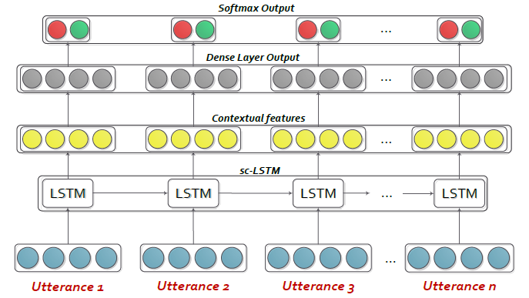
bcLSTM
idea: traditional methods ignore the interactions between utterances.
method: deploy an LSTM to model the interactions between utterances.
Step 1: For audio modal: openSMILE; For visual modal: 3D-CNN; For textual modal: text-CNN
Step 2: concatenate features from 3 modals and process them using LSTM
Structure:
The first baseline for ERC.

Slide 10
CMN
idea: previous works ignore the inter-speaker interactions in dyadic conversations.
method: two GRUs respectively modeling the two speakers and memory networks for interactions.
Step 1: For audio modal: openSMILE; For visual modal: 3D-CNN; For textual modal: text-CNN
Step 2: CMN for conversational context modeling.

Slide 11
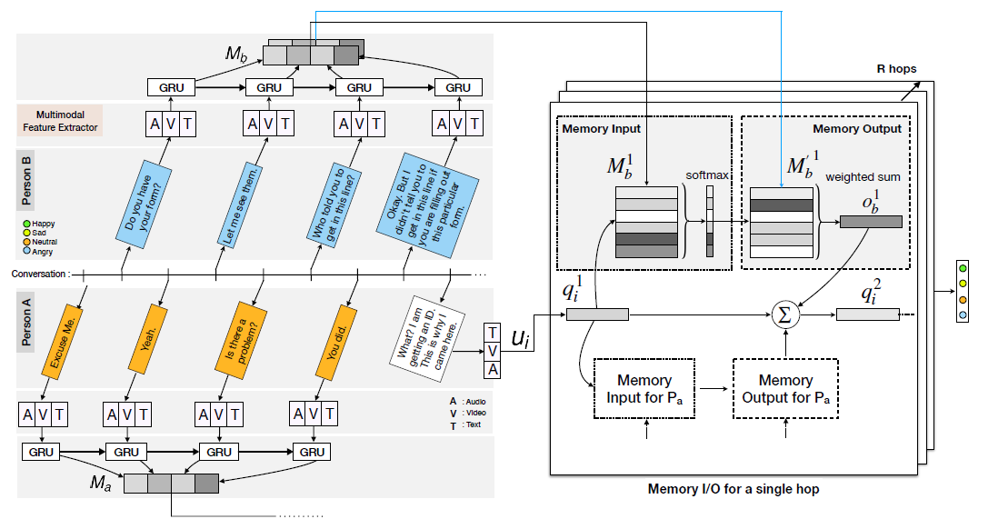
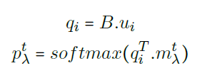
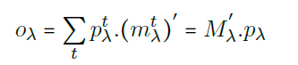
CMN
Standard Memory Network operation
Problems: the original sequence of the conversation is broken down; only
adapted for dyadic conversations.

Slide 12
DialogueRNN
idea: previous works(CMN, ICON) cannot fit the multi-speaker conditions.
method: new speaker modeling proposed: speaker + listener modeling.
Step 1: For audio modal: openSMILE; For visual modal: 3D-CNN; For textual modal: text-CNN
Step 2: DialogueRNN for conversational context modeling.
The current participator is the speaker and other participators are listeners.

Slide 13
DialogueRNN
Global GRU
Party GRU
Listener GRU
Emotion GRU
GRU_{g}
GRU_{p}
GRU_{L}
GRU_{E}
Global sequence modeling
Speaker modeling
Listener modeling
Emotion output

Slide 14
DialogueRNN
Speaker
Modeling
Ap_{t-1}
GRU_{p}
Ap_{t}
u_{t}
e_{t-1}
GRU_{E}
e_{t}
attention
g₁
…
g_{t-1}
GRU_{g}
g_{t}
Global Line
v_{t}
Bp_{t-1}
GRU_{L}
Bp_{t}
Listener
Modeling
Bp_{t-1}
Bp_{t}
No systematic speaker modeling, and
inter-speaker modeling is absent.
RNN suffers from long-distance dependency.

Slide 15
DialogueGCN
idea: a new and systematic speaker modeling is applied.
method: Relational Grpah Convolutional Network to process the relational graph.
Step 1: For textual modal: text-CNN. Uni-modal modeling.
Step 2: DialogueGCN for conversational context modeling.

Slide 16
DialogueGCN
Speaker modeling:
Surprise
Neutral
Neutral
Anger
铁汁, 你喜欢这部电影嗦?
你真的喜欢哈?
具体喜欢它哪一pa?
有袋鼠的那一场你觉得如何?
你批娃睡着了!
Joey
Chandler
嗯咯, 是滴!
全部嗷, 我们可以溜了嘛
..., 世界大战的电影里面冒出
一只袋鼠, 我表示很惊讶
你莫走嘛,
哎哟, 骚瑞
Joy
Neutral
Surprise
Sadness

Slide 17
DialogueGCN
Speaker modeling:
Self dependency
Inter-speaker dependency
Surprise
Neutral
Neutral
Anger
铁汁, 你喜欢这部电影嗦?
你真的喜欢哈?
具体喜欢它哪一pa?
有袋鼠的那一场你觉得如何?
你批娃睡着了!
Joey
Chandler
嗯咯, 是滴!
全部嗷, 我们可以溜了嘛
..., 世界大战的电影里面冒出
一只袋鼠, 我表示很惊讶
你莫走嘛,
哎哟, 骚瑞
Joy
Neutral
Surprise
Sadness

Slide 18
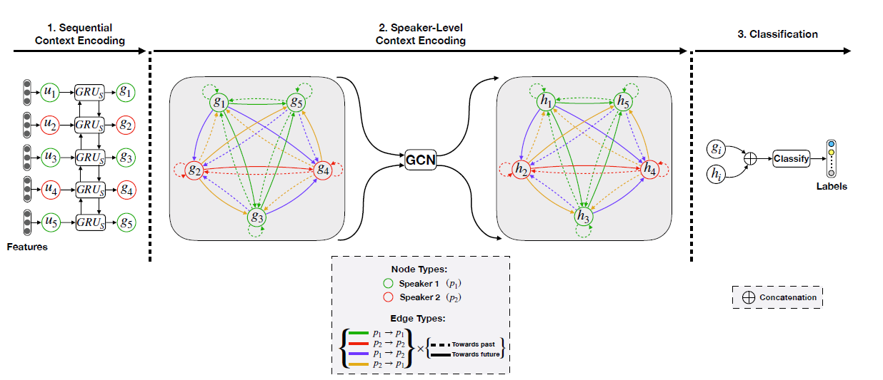
DialogueGCN
Speaker modeling:
Neutral
Self dependency
具体喜欢它哪一pa?
Inter-speaker dependency
Surprise
Neutral
铁汁, 你喜欢这部电影嗦?
你真的喜欢哈?
有袋鼠的那一场你觉得如何?
嗯咯, 是滴!
全部嗷, 我们可以溜了嘛
2x(2^2)=8 relations
Joy
Neutral
2M^2 relations

Slide 19
DialogueGCN
Sequential context encoding is extremely important
to achieve good performance

Slide 20
DialogueGCN
1 RGCN layer
1 GCN layer

Slide 21
DialogueGCN
Residual connection
Problem: complicated speaker modeling; no position modeling for the relational graph.

Slide 22
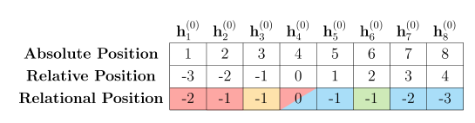
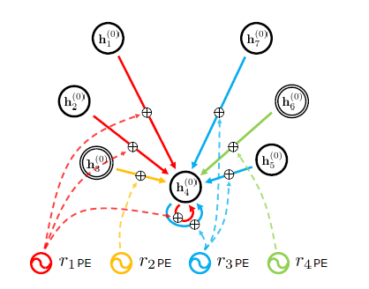
DialogueGCN + Position Modeling
Idea: position modeling need to be applied in relational graphs.
Method: learnable relative position encoding added to every edge of relational graphs.
One step: BERT for text encoding; stacked RGAT(RGCN) for conversational context modeling.
👏👏👏👏👏👏👏👏👏👏👏👏👏👏👏👏👏👏👏👏👏👏👏👏👏👏
new relative position for new relation.
EMNLP2020👏

Slide 23
HiTrans
Idea: contextual and speaker information is important for ERC.
Method: hierarchical transformer and an auxiliary task for speak modeling.
One step: BERT for text encoding, transformer for conversation modeling plus multi-task learning.
Structure:
Transformer
Results are not trustable because of no
clue for multiple runs.
BERT
Problem: speaker modeling becomes
a task need to be predicted. For inference,
no explicit speaker information is used.

Slide 24
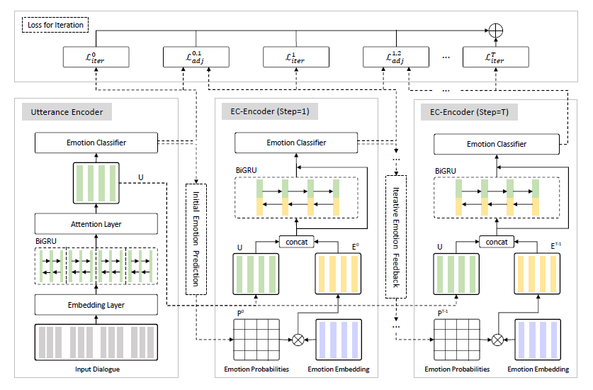
EIN
Idea: golden labels of context utterances can guide the prediction of the current utterance. But no
Golden labels are provided in inference time. An iterative interaction module is proposed.
Name: Emotion Interaction Network.
Institute: Harbin Institute of Technology.
COLING 2020

Slide 25
EIN
Utterance encoding: biGRU + Attention;
to get the representation of every utterance.

Slide 26
EIN
For every emotion, an emotion embedding is assigned; the prediction of emotion classifier is used as attention score to pick up the proportion of emotions for further process; and the attentive emotion information is concatenated with the utterance embeddings to further model conversational context.

Slide 27
EIN
The prediction of emotion classifier is iteratively assigned to pick up emotion information from emotion embeddings, and the information will be more refined with several iterations.

Slide 28
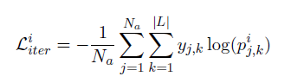
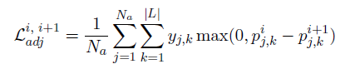
EIN
Iterative cross entropy loss, and margin ranking loss are respectively applied in every iteration and every two adjacent iterations.
The major hyper-parameter is the number of iterations.

Slide 29
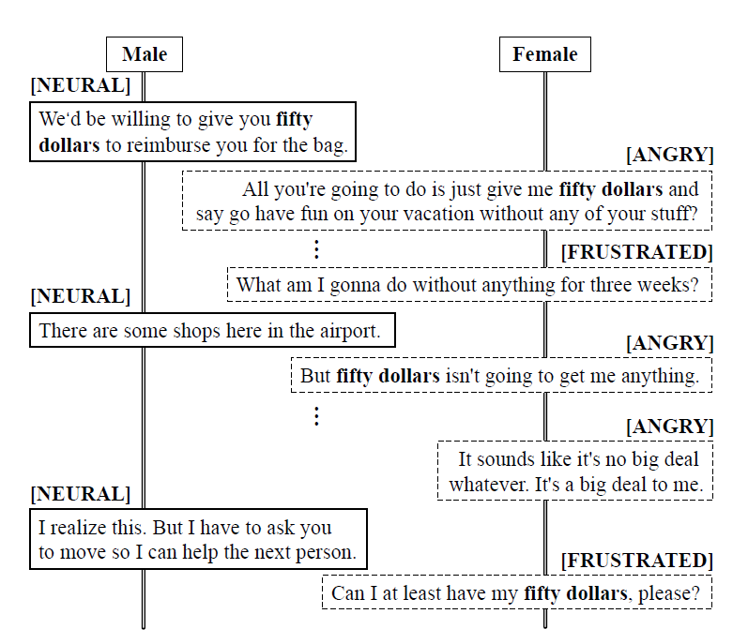
SumAggGIN
Idea: previous works only focus on utterance-level features and pay little attention on phrase-level connections between utterances. Some important phrases are required to be emphasized.
Method: A two-stage summarization and aggregation Graph Inference Network is proposed.
Institute: Shenzhen Graduate School, Tsinghua Uni.
COLING 2020
客运公司把人包搞落了, 然后讨论补偿, 然后扯皮的这么一个主题

Slide 30
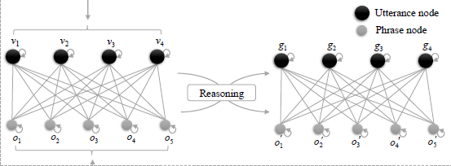
SumAggGIN
Utterance encoding: TextCNN + biLSTM to get n utterance representations.
Topic-related phrase extraction: TextRank to get m key phrases.
A Heterogeneous Graph of utterances and key phrases are constructed.
If a key phrase is appeared in an utterance, there is an edge connecting these two nodes and the edge weight is the tf-idf.
Furthermore, a GAT is applied to process this heterogenous graph and get the updated features of utterances for further process

Slide 31
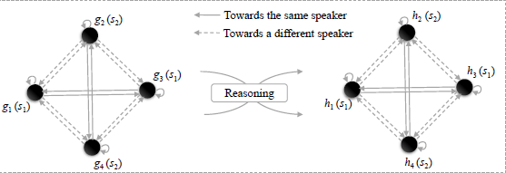
SumAggGIN
Furthermore, with the updated representations of utterances, a speaker-aware graph is constructed (which is similar with DialogueGCN) to obtain the local contextual information from neighboring utterances.
The structure to process this graph is the same as that of DialogueGCN, and the output is used to predict the final emotion.

Slide 32
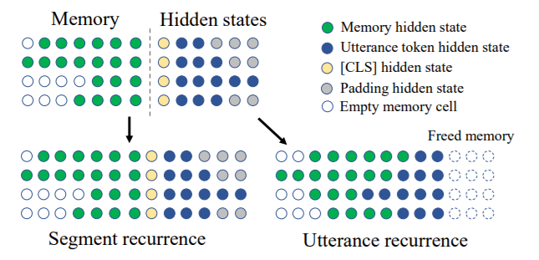
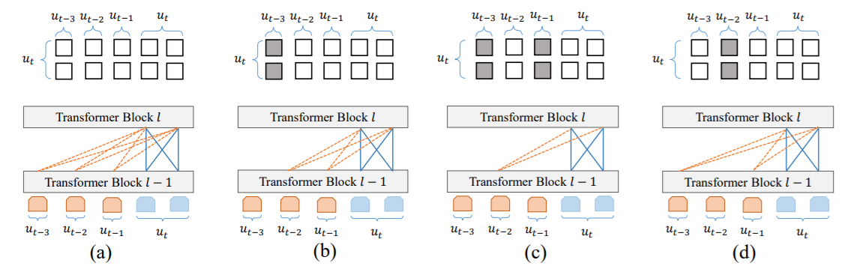
DialogXL
Idea: recent works is based on the hierarchical structure and the pre-trained model like XLNet is not applied in ERC.
Method: A all-in-one structure based on XLNet is proposed and no hierarchical structure is used in this work.
1. Utterance recurrence replaces segment recurrence; 2. speaker modeling mask.
Mix four mask in XLNet attention heads of every layer.
Ignore [CLS] and padding to get a longer context.

Slide 33
TimeLine
Part of ERC works
ACL 2017
NAACL 2018
EMNLP 2018
AAAI 2019
NNACL 2019
IJCAI 2019
AAAI 2020
EMNLP 2019
EMNLP 2020
Findings 2020
COLING 2020
AAAI 2021
DialogueGCN+Pos
bcLSTM
ICON
HiGRU
AGHMN
COSMIC
DialogXL
CODE
CMN
DialogueRNN
ConGCN
DialogueGCN
HiTrans
QIN
KET
EIN
SumAggGIN
KAITML

Slide 34
Emphasis
Part of ERC works
Context modeling
Speaker modeling
Emotion augmentation
Key phrase emphasis
Knowledge inclusion
bcLSTM
CMN
EIN
SumAggGIN
KET
HiGRU
ICON
COSMIC
QIN
DialogueRNN
KAITML
AGHMN
ConGCN
CODE
DialogXL
DialogueGCN
HiTrans
DialogueGCN+Pos

Slide 35
Other similar tasks
Emotion Reference in Conversation.
Sentiment Analysis in Conversation.
Dialogue Act Classification.

Slide 36
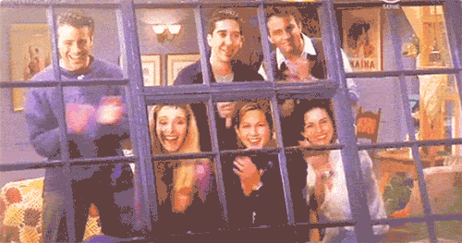
The End

